Slide 1

BSFX
Forex Automated Trading Platform

Slide 2
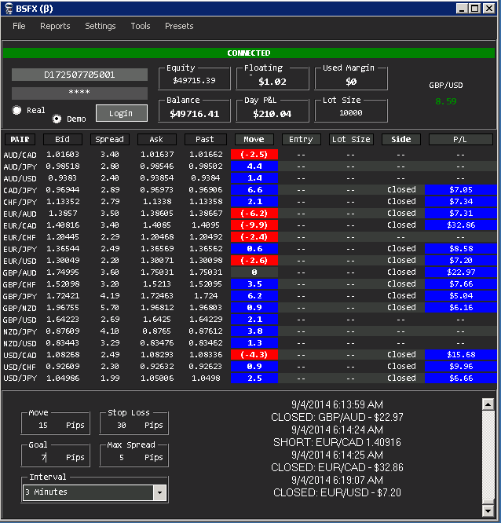
What’s covered
What is Forex?
Basics
Making Money
Price Action
What is it?
Why is it important?
FXCM
What is FXCM?
Free Practice Account
FXCM Trading Platform
Dealing Desk/No Dealing Desk
Forex Connect API
BSFX
Concept
Used Pairs
Data
Demo vs Real
The Grid
Parameters
Interval’s
Past Price
Move
100 Move, 50 Goal, 4 Hours
Order Placement
Winning Parameters
Reports

Slide 3
WHAT IS FOREX?

Slide 4
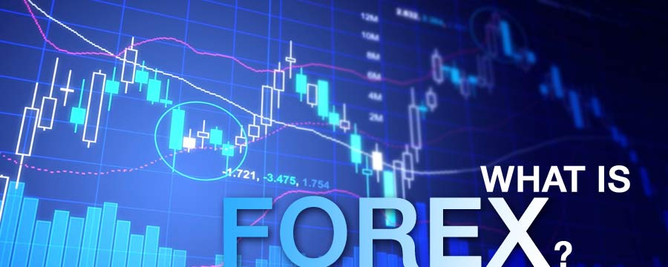
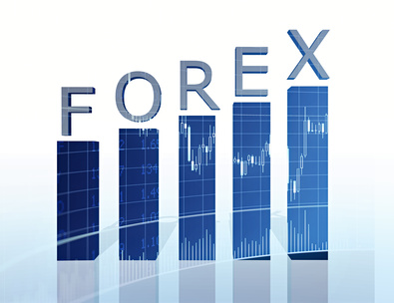
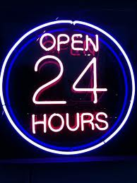
Forex, or Foreign Exchange Market, is a global decentralized market for the trading of currencies.
Forex is the most liquid financial market in the world.
Forex assists international trade and investments by enabling currency conversion.
In a typical Forex transaction, a party purchases some quantity of one currency by paying for some quantity of another currency.
These currencies, are referred to as “Pairs”.
Example: GBP/USD (Great British Pound/United States Dollar)
Foreign exchange markets averaged $5.3 trillion per day in April 2013.
About 70% to 90% of the foreign exchange transactions conducted are speculative.
This means the person or institution that bought or sold the currency has no plan to actually take delivery of the currency in the end; rather, they were solely speculating on the movement of that particular currency.

Slide 5
SO HOW DO YOU MAKE MONEY?

Slide 6
FIRST, SOME BASICS…
PAIRS
There are many official currencies that are used all over the world, but only a handful of currencies that are actively traded in the forex market.
In general, the eight most traded currencies (in no specific order) are the U.S. dollar (USD), the Canadian dollar (CAD), the euro (EUR), the British pound (GBP), the Swiss franc (CHF), the New Zealand dollar (NZD), the Australian dollar (AUD) and the Japanese yen (JPY).
PIP (Percentage In Point)
A pip is a very small measure of change in a currency pair in the forex market.
A pip is a standardized unit and is the smallest amount by which a currency quote can change, which is usually $0.0001 for U.S.-dollar related currency pairs, which is more commonly referred to as 1/100th of 1%, or one basis point.
SPREAD
The bid-ask spread is simply the difference between the price at which a dealer will buy a currency and the price at which the dealer will sell a currency.
BASE CURRENCY: US Dollar
SPREAD: 0.7747 – 0.7743 = 4 pips
BID PRICE: You can sell $1 for 0.7743 Euro’s
0.7743/4.1/0.7747
USD/EUR
0.7743/4.1/0.7747
ASK PRICE: You can buy $1 for 0.7747 Euro’s.
QUOTE CURENCY: Euro

Slide 7
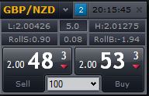
So to make money…
We first need to understand how prices are set for currency pairs.
Lets use GBP/NZD in an example…
1. Place an order for 10,000 NZD
2. The purchase price for 1.00 NZD is £2.00533.
3. Bill deposits £20,053.30 to maintain 10k NZD
7. Bill receives £20,073.30
8. Bill has made £20.00
5. Bill places an order to sell back 10k NZD
4. The value of the NZD rises 20 pips
6. The sell price for GBP/NZD is now 2.00733
9. FXCM pays you, based on your currency for the same value.
Spread: 5.0
Bid: 2.00483
Ask: 2.00533
So if a trader,
Let’s call him Bill
Wants to trade.
Bill would…

Slide 8
PRICE ACTION

Slide 9
What is price action?
In simple terms, price action is a trading technique that allows a trader to read the market and make trading decisions based on the actual price movement on the chart, rather than relying on lagging indicators.
Or a more technical explanation:
Price action is the movement of a security's price. This action is encompassed in technical and chart pattern analysis, which attempts to find order in the sometimes seemingly random movement of price. Swings (high and low), tests of resistance and consolidation are some examples of price action.

Slide 10
Why is price action so important?
Price action traders keep things simple, which can also be an effective methodology when it comes to trading.
These traders rely on a combination of price movement, chart patterns, volume, and other raw market data to gauge whether or not they should make a trade.
This is seen as a "simplistic" and "minimalist" approach to trading but is not by any means easier than any other trading methodology.
The purest form of price action trader is a “tape reader”.
Good tape readers don't need charts, although some may glance at a chart occasionally, especially if they're in a position - they may be looking for support or resistance areas to take profits.
However, it is rare to find a tape reader using any indicators or oscillators.
Their primary tools will be the TIME & SALES WINDOW and perhaps their Depth of Market (DOM) if they can multi-task.
It can be used on any market at any time under any circumstances (E-Mini S&P, Forex, stocks, other commodities, futures and currencies).
It is fast - Price lag is irrelevant, old data will not obstruct trading.
It is versatile - Price action trading methods can be combined for a coherent trading system that is free of conflicting data.

Slide 11
FXCM

Slide 12
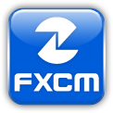
What is fxcm?
FXCM, is an online Foreign exchange market broker based in the United States.
FXCM allows retail and institutional clients to speculate on global foreign exchange markets in what is known as "margin forex trading".
FXCM is the chosen broker of BSFX, due to it’s dependability and accuracy of it’s API client: ForexConnect API.

Slide 13
Free practice account
A practice account utilizes virtual currency to test trading strategies.
FXCM offers an unlimited amount of practice accounts.
All practice accounts contain $50,000 of virtual funds.
Trades executed through practice accounts, closely resemble live trading.
If testing strategies, or learning BSFX, is your goal, open a practice account.
Fill this form out, then save your user name and password.
http://www.fxcm.com/forex-trading-demo/

Slide 14
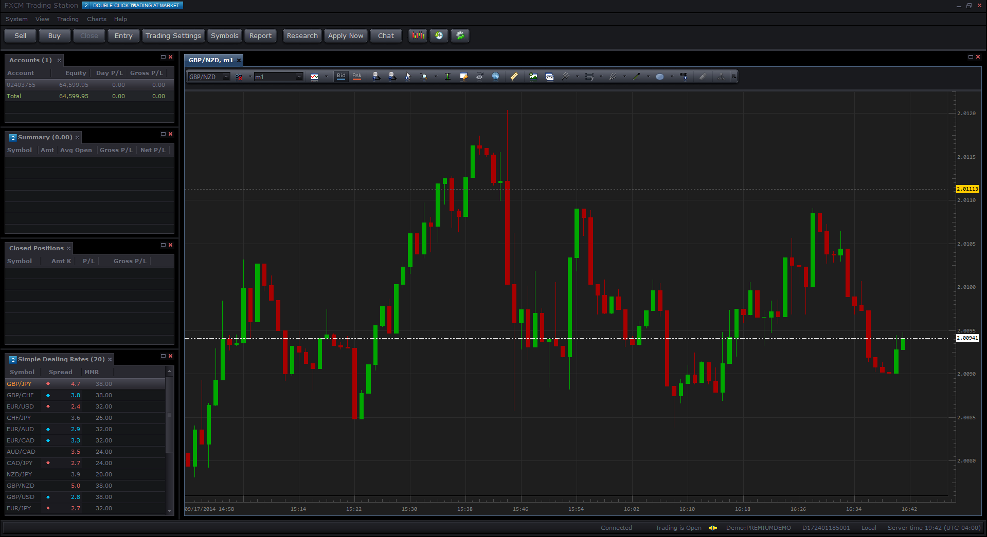
FXCM Trading Station
Trading station is FXCM’s trading platform.
Trades can be executed, and account information can be reviewed.
Reports can be generated from Trading Station
Since BSFX sends all orders to FXCM (live or not), you can check the accuracy of BSFX by comparing trades at the broker.
Manual trades can be placed through trading station, minimizing the middle man.
Trading station uses the same data that BSFX uses.

Slide 15
Dealing desk/no dealing desk
Dealing desk
No dealing desk
FXCM can act as a dealer on some or all currency pairs.
FXCM is the counterparty to any trades that you undertake.
FXCM will choose the BID/ASK price based on the lowest risk for them.
These prices are chosen from over 1,000 different data providers.
When you place an order, the BID/ASK prices can differ up to 20 pips, from the prices before you made the trade.
This inheritably causes more risk for YOU.
FXCM acts as a price aggregator.
No trading conflict of interest between broker and trader.
No re-quotes; no dealer intervention.
BID/ASK prices remain consistent.
When you place an order, both BID and ASK prices remain the same, before the trade was executed.
FXCM chooses the best price, based on over 1,000 different data providers.
BSFX recommends going with NO DEALING DESK.

Slide 16
Forex connect api
Forex Connect is the name of the API (Application Programming Interface), utilized by FXCM, to send data, and receive orders from their clients.
The API is an event driven, table based, data interface.
Offers immediate data updates.
Quick data exchange is crucial in Forex.
No need to request data.
Up to the second data updates.
All functionality in Trading Station is included within the API.
BSFX can replicate what FXCM’s trading platform does.
Helps create uniformity between BSFX and FXCM’s Trading Station.
If BSFX shows a bid and ask price, that same bid/ask will mirror what is shown in Trading Station.

Slide 17
BSFX Explained

